Slide 1
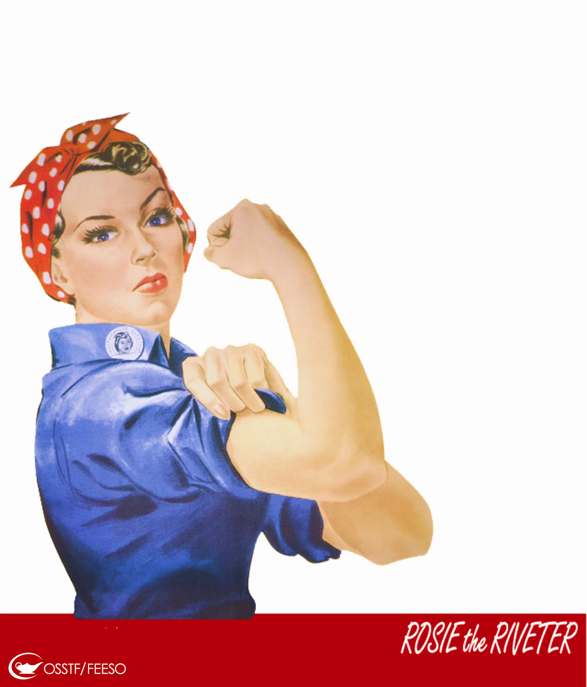
Leadership, Feminism and Equality in Unions in Canada
Are we there yet?
OFL Women's Leadership Summit
Barrie, December 2012
Presentation by Linda Briskin & Margaret McPhail

Slide 2
Our Project
Leadership, Feminism and Equality in Unions in Canada
This project explores the current climate and attitudes to women, feminism, leadership and equality in Canadian unions through the insights, voices and experiences of women union leaders, activists and staff.
Unions in Canada have played a significant role in promoting women’s equality. Yet evidence suggests that equality issues have still not moved into the mainstream of union culture. In the current climate of recession, cutbacks, and austerity, we may even be losing ground.
Through this project, we hope to bring together a community of women activists from across unions and to stimulate discussions on how to move forward.
Copyright © Linda Briskin, Sue Genge, Margaret McPhail and Marion Pollack. All rights reserved. Feel free to reproduce material from this website but be sure to attribute material to womenunions.apps01.yorku.ca. Please also let us know
how you are using this material.

Slide 3
Lessons about change
A Struggle to Remember:
Female membership “ran past the leadership”
Women’s organizing “won over” key male leaders
Rank & file activism created a foundation for women as union leaders
…. It’s in our collective hands

Slide 4
“Sister to Sister”
Women are going to form a chain,
a greater sisterhood than the world has
ever known.
Nellie McClung, 1916

Slide 5
Unions and women’s equality
“The trade union movement is one of the few organizations in society with the capacity to make changes on behalf of working people.”
At the same time:
“Unions are institutions that can either push forward on social change or hold it back.”

Slide 6
Challenges and strategies
Encouraging & supporting women leaders
Re-visioning women’s committees
Understanding the impact of the social & economic climate on women’s equality organizing

Slide 7
Encouraging Women Leaders
The numbers
Majority of union members are women
Majority of leaders are men
Picture even more troubling for Aboriginal & racialized women, and women with disabilities
Not only a question of numbers
"For me it's not just about union leaders being women, it's about the politics they represent."

Slide 8
Encouraging Women Leaders
Isolation and burn-out
“True trade unionist” = 24/7
Work/life balance continues to be a challenge
“The challenge for us is how do we see women taking on greater responsibilities in the labour movement and still juggle the whole family.”

Slide 9
Encouraging Women Leaders
Still a chilly climate
Disrespect
Undermining, isolation & dismissal of women, especially when outspoken or critical
Limitations put on their roles and autonomy
Ignored in discussions
Excluded from key meetings and discussions
“As a leader, there has been very little respect for me from the top ... and that disrespect has trickled its way down over the years.”

Slide 10
Encouraging Women Leaders
Marginalization
Experiences of Aboriginal, racialized & young women
“Speaking as a racialized women, I know that racialized women have said, ‘You know what? We’re tired of being marginalized and, if we challenge the labour movement, being completely written off and having whatever we’re putting forward being completely undermined.”

Slide 11
Encouraging Women Leaders
A culture of fear
Chilling effect on activists
“Women … are ducking for cover. They won’t challenge the bullying because they don’t want to be targets.”

Slide 12
Encouraging Women Leaders
Cyberbullying
Often focused on sexuality, personal relationships and character
“People feel freer to attack women in very much more personal ways than they attack men”

Slide 13
Encouraging Women Leaders
“I believe that women’s equality took a back seat a long time ago - particularly in the union movement. We’re back at a time where the only time you seem to get noticed as a woman, even if you are a leader, is either when you’re a shit disturber - and when you’re a shit disturber you get dismissed or marginalized – or you behave like one of the boys.”

Slide 14
Encouraging Women Leaders
“Disturbers are never popular -- nobody ever really loved an alarm clock in action-no matter how grateful they may have been afterwards for its kind services!"
Nellie McClung

Slide 15
Strategy #1
The numbers:
Designated seats
Ceilings, not floors
On collective bargaining teams

Slide 16
Strategy #1
Develop new pools of leadership
Work with younger activists
“When I hear other people talk about young people I am much more optimistic … I see these young women activists ... who are really smart and progressive and engaged. And by and large, the majority of them would identify themselves as feminists but not quite in the same way I think my generation did and does.”

Slide 17
Strategy #2
Isolation and burn out:
Work/life balance campaign
Bring into union as well as workplace

Slide 18
Strategy #2
Support our women leaders
"The one word I've used to describe my position … it's lonely … You end up being very isolated and people know you're busy so your friends don' t call as often … (you need) somebody to call you up on a bad day and say, “You know, I was just thinking of you.' Those kind of things that, as we become leaders, people think we don't need."

Slide 19
Strategy #3
The climate
Break the silence
Develop ways to speak collectively
"A lot of the sisters are keeping their heads down in their unions because they want to keep doing the work that they love. But I think the only way out of this is to start saying everything out loud.“
It’s not whining
“What I found with most of the inequality … was that it was subtle. And when I tried to confront it … I was told I was overreacting, which I’m sure a lot of women hear.”

Slide 20
Strategy #3
Enforce harassment policies
“There needs to be more than the token ‘We have inclusiveness.’ … Not just ‘We have a harassment policy’ echoed at every meeting … We’ve got to walk and talk it, right?”

Slide 21
Strategy #3
Support new forms of leadership
“You need to use a certain language; you need to have a certain stance. Like there’s still … that sort of machismo vision of what a union leader is as somebody who pounds the table.”
“I remember bargaining back when I had young children … and I was bargaining around the clock ... you couldn’t do it any other way. Who says you can’t do it any other way? ... You don’t have to do this model of combat through the night and wear everyone down and whoever survives the longest can actually get to an agreement.”

Slide 22
Strategy #3
Support new forms of leadership
“Lots of women expect their leaders to have sort of male traits … They don’t seem to value ... an inclusive way of doing things, genuinely respecting other opinions and differences, and working through conflict in a way that respects people.”

Slide 23
Women’s Structures: Do they still work?
Women’s committees provide opportunities for sisters to meet collectively to:
Identify issues
Set an agenda and strategy
Organize to bring about change
Also offer:
Training ground to develop organizing and leadership skills, and build self-confidence
Legitimacy and structured support

Slide 24
Women’s Structures: Do they still work?
Institutionalization
Formalized structure also means barriers
"One of the things that happened with the creation of committees is that we fought for these committees … to advance women's issues and women's equality, but they became very constrained and confined spaces.”

Slide 25
Women’s Structures: Do they still work?
Can sideline grassroots activists
"My understanding of the feminist movement, and particularly in the labour movement, was there was this wave of women doing really wonderful things … there was no structure. But … one structure was put into place - women's committees - … and it forced ....women to fit into the structure.”

Slide 26
Women’s Structures: Do they still work?
Narrowed mandate & vision
“Women’s committees seem to not be taking on women’s issues more so than taking time for each other, which is very important but still it’s not moving the feminism agenda forward.”
“Women’s committees are expected to organize around International Women’s Day and December 6th and those are the points … that all of our work revolves around ... Commemorating these days is very important...but shouldn't be the only thing that we focus on.”

Slide 27
Women’s Structures: Do they still work?
Lack of power
Not linked to campaign priorities
"Changes in the [labour] movement meant that the women's committees now have very little - if any- clout. They have to sort of toe the line as to the campaigns that are put out there for them.

Slide 28
Women’s Structures: Do they still work?
Not perceived as way to leadership
“What I’m finding with a number of young women – extraordinarily talented, brilliant, future leader women – is that … they want to be a good organizer, a mobilizer. They want to be known as an expert in health and safety … They do not want to be known as a leader on equity.”

Slide 29
Women’s Structures: Do they still work?
Not linked to core union functions
“The fact is women’s committees have no power in the structure of many unions ... You have the health & safety committee, which has the regs … and real power at the workplace. You have the grievance committee, which has its own power ... The women’s committee has no power.”
Not tied to rank & file activism
“You piss them off and you’re not there any more.”

Slide 30
Women’s Structures: Do they still work?
Intersectional organizing
Tokenism and “siloing”
“There's this sense of equity tokenism where if you have a lesbian or an Aboriginal woman or a woman with a disability that is the accomplishment in itself.“

Slide 31
Women’s Structures: Do they still work?
Feminism and diversity
“Yet mainstream feminist – I mean white women’s issues – are everybody’s issues, right? Whether it’s the issue of pay equity or childcare or the right to choose. It impacts all women. It just impacts other women who self-identify from equity groups differently.”

Slide 32
Women’s Structures: Do they still work?
Competition
“”It’s like there’s one pie and there’s only so many pieces. And then the minority groups are going after that same piece. I’ve seen the competition and the stepping on each other and the game playing to get that one piece.”

Slide 33
Strategy #1
Intersectional Organizing:
Strength the balance
“To a certain degree we need a space to bring equity groups together to have that dialogue, to be able to talk to women about issues that impact racialized or other women ... Yet you also need the space to self-mobilize and organize and discuss issues separately … There needs to be a balance.”

Slide 34
Strategy #1
Ensure real representation
Challenge misperceptions/build inclusive analysis
Reach out to strengthen cross-constituency organizing and support for a broad equality agenda
“Women need to self-organize like they did in the past and try to be outside their own union structures ... Women will have to have these discussions about what women can do … so we can work collectively as opposed to little silos or isolated.”

Slide 35
Strategy #2
Renew our women’s committees:
Organize from the margins
"Instead of being confined to the traditional convention women's forum where it's very controlled and where there's speakers from the front, women delegates met as caucus … around trying to fight for structural changes … That was a glimmer of hope - women organizing outside the confines of a committee."

Slide 36
Strategy #2
Revision the role of women’s committees
“Most of our unions do have women’s committees but they’re not really pushing the political agenda.”
“Women’s committees are struggling. They're struggling to figure out what they should be doing, but there’s a kind of hunger out there to do things.”
Develop links to core functions
"You know we tend to lobby for women's equality more than we negotiate for women's equality."

Slide 37
Strategy #2
Build a new base of power
"It's not just about leaders … because if you just have individuals at the top, you’re not going to have the power to bring about change."
“Unless [women’s voices] are connected to some kind of power base that men understand, they really don’t hear you.”
"I'm heartened by the fact that … women may not be participating as much at the top levels of leadership... but at the local level, women are engaging ... a lot of local leadership is female."

Slide 38
Big Picture & Women’s Equality
Economic and Political Context
Significant job loss in government and private sector
Rise in precarious, part-time and casual employment
Increase in demands for bargaining concessions
Attacks on public services
Legislation limiting and eliminating free collective bargaining and organizing
Federal legislation limiting women’s rights: pay equity, choice, child care
Anti-immigrant and refugee legislation that encourages racism and ethnocentrism

Slide 39
Big Picture & Women’s Equality
Women disproportionately affected
“What we’ve seen most recently around austerity is … employers taking advantage as well as governments to lower the bar … And this is clearly having an impact on women’s situation.”

Slide 40
Big Picture & Women’s Equality
Challenges for Equality Organizing
Austerity inside unions
“It feels like the union movement these days is mirroring the … broader conservative trends in society, as opposed to challenging them.”
“The economic realities …[have] given the leadership at all levels an opportunity or an excuse as to why they can’t fund programs which support women’s equality.”

Slide 41
Big Picture & Women’s Equality
Sidelining equality issues
“When I started … there was a gender lens on almost everything … And it seems like now there is nothing: there is no gender lens, there is no equality lens … We’ve now become an aside again.”
“There was an analysis done of the federal budget and I read it and so help me God, I almost started to weep. If I’d had time to cry I would have. There wasn’t one mention of women in that analysis.”

Slide 42
Big Picture & Women’s Equality
Dropping language of equality
Change in language obscures gender & other forms of discrimination
“You know when Harper came in, he decided the word equality needn’t be in things. I never thought I would have the same debate within my own union to maintain a word like equality.”

Slide 43
Strategy #1
Equality & diversity key to union renewal strategy
“When we … say, ‘Listen, we can’t have a discussion about union renewal without talking about equality’, [we’re told] … ‘we don’t have time to talk about equality. We have to talk about saving unions, saving workers and saving jobs’… The people who are at the decision making tables, don’t see … that equality is part of …
that strategy.”
“There’s a tremendous amount of stuff to fight and I guess that is [the] reason why we hear ‘Yeah, yeah. We’ll get to the women’s stuff later’ … But maybe there is some way that we can use this as an opportunity to try and mobilize women.”

Slide 44
Strategy #2
Organize across unions
“Some of my earliest involvement in and around the labour movement was very much working across unions and we were very much outside the establishment and fighting to become established. And maybe it's like wishing we could go back to some of that … It's more of that bringing women together across unions and outside of the top-down structures. More grassroots organizing again.”

Slide 45
Strategy #3
Rebuild links with women’s organizations
“We do not have the women’s movement that we had when most of us got engaged in advancing women’s equality within unions. The … women’s movement is far weaker and that reduces the power of women within the labour movement because we don’t have the kind of leverage that helped us make some of the moves that we did before.”
“The labour movement … was more willing to listen to women inside the movement because they knew some pressure would come from those outside structures.”

Slide 46
Are we there yet?
There are still challenges to women’s equality within the labour movement today
So what do we do?
Organize, organize, organize!
“She who waits for roast duck to fly into her mouth must wait a very long time.”

Slide 47
But remember also …
“As much as things may seem very bleak, there’s some rainbows out there, sisters!”

Slide 48
“Sister to Sister”
“I just want to say that whatever form it takes we have to keep having this conversation. I’m happy I’m having it with different women and the circle is so large and the interest so large, because I’m sick of just whining to the same people. Not that I don’t love the people I whine to, but it’s nice to hear different voices and different ideas and different experiences ...
I started out despairing and I still feel despair,
but I’m also feeling some excitement.”

Slide 49
“Sister to Sister”
In our presentations, you heard the voices of many sisters.
What comments resonated with your own experience?
What would you like to add?

